Slide 1

Trends in Obesity Rates How is obesity distributed across the US? Brian Stogner Stephanie Hucks Andrea Pappa Stacey Poole

Slide 2
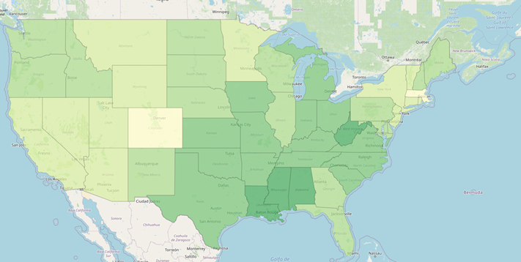
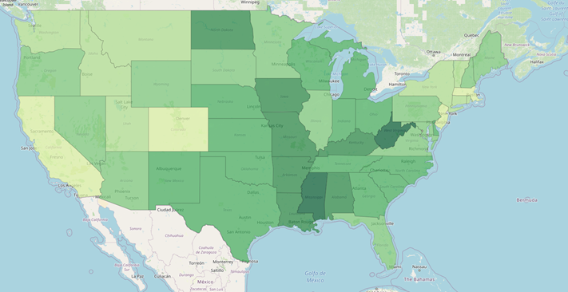
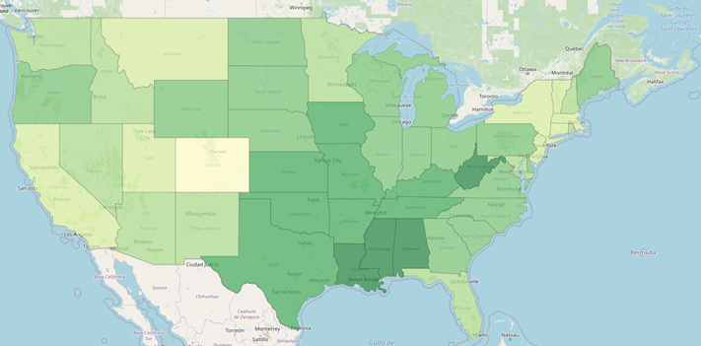
Obesity rates have been increasing in the United States.
2011
2018
2015

Slide 3
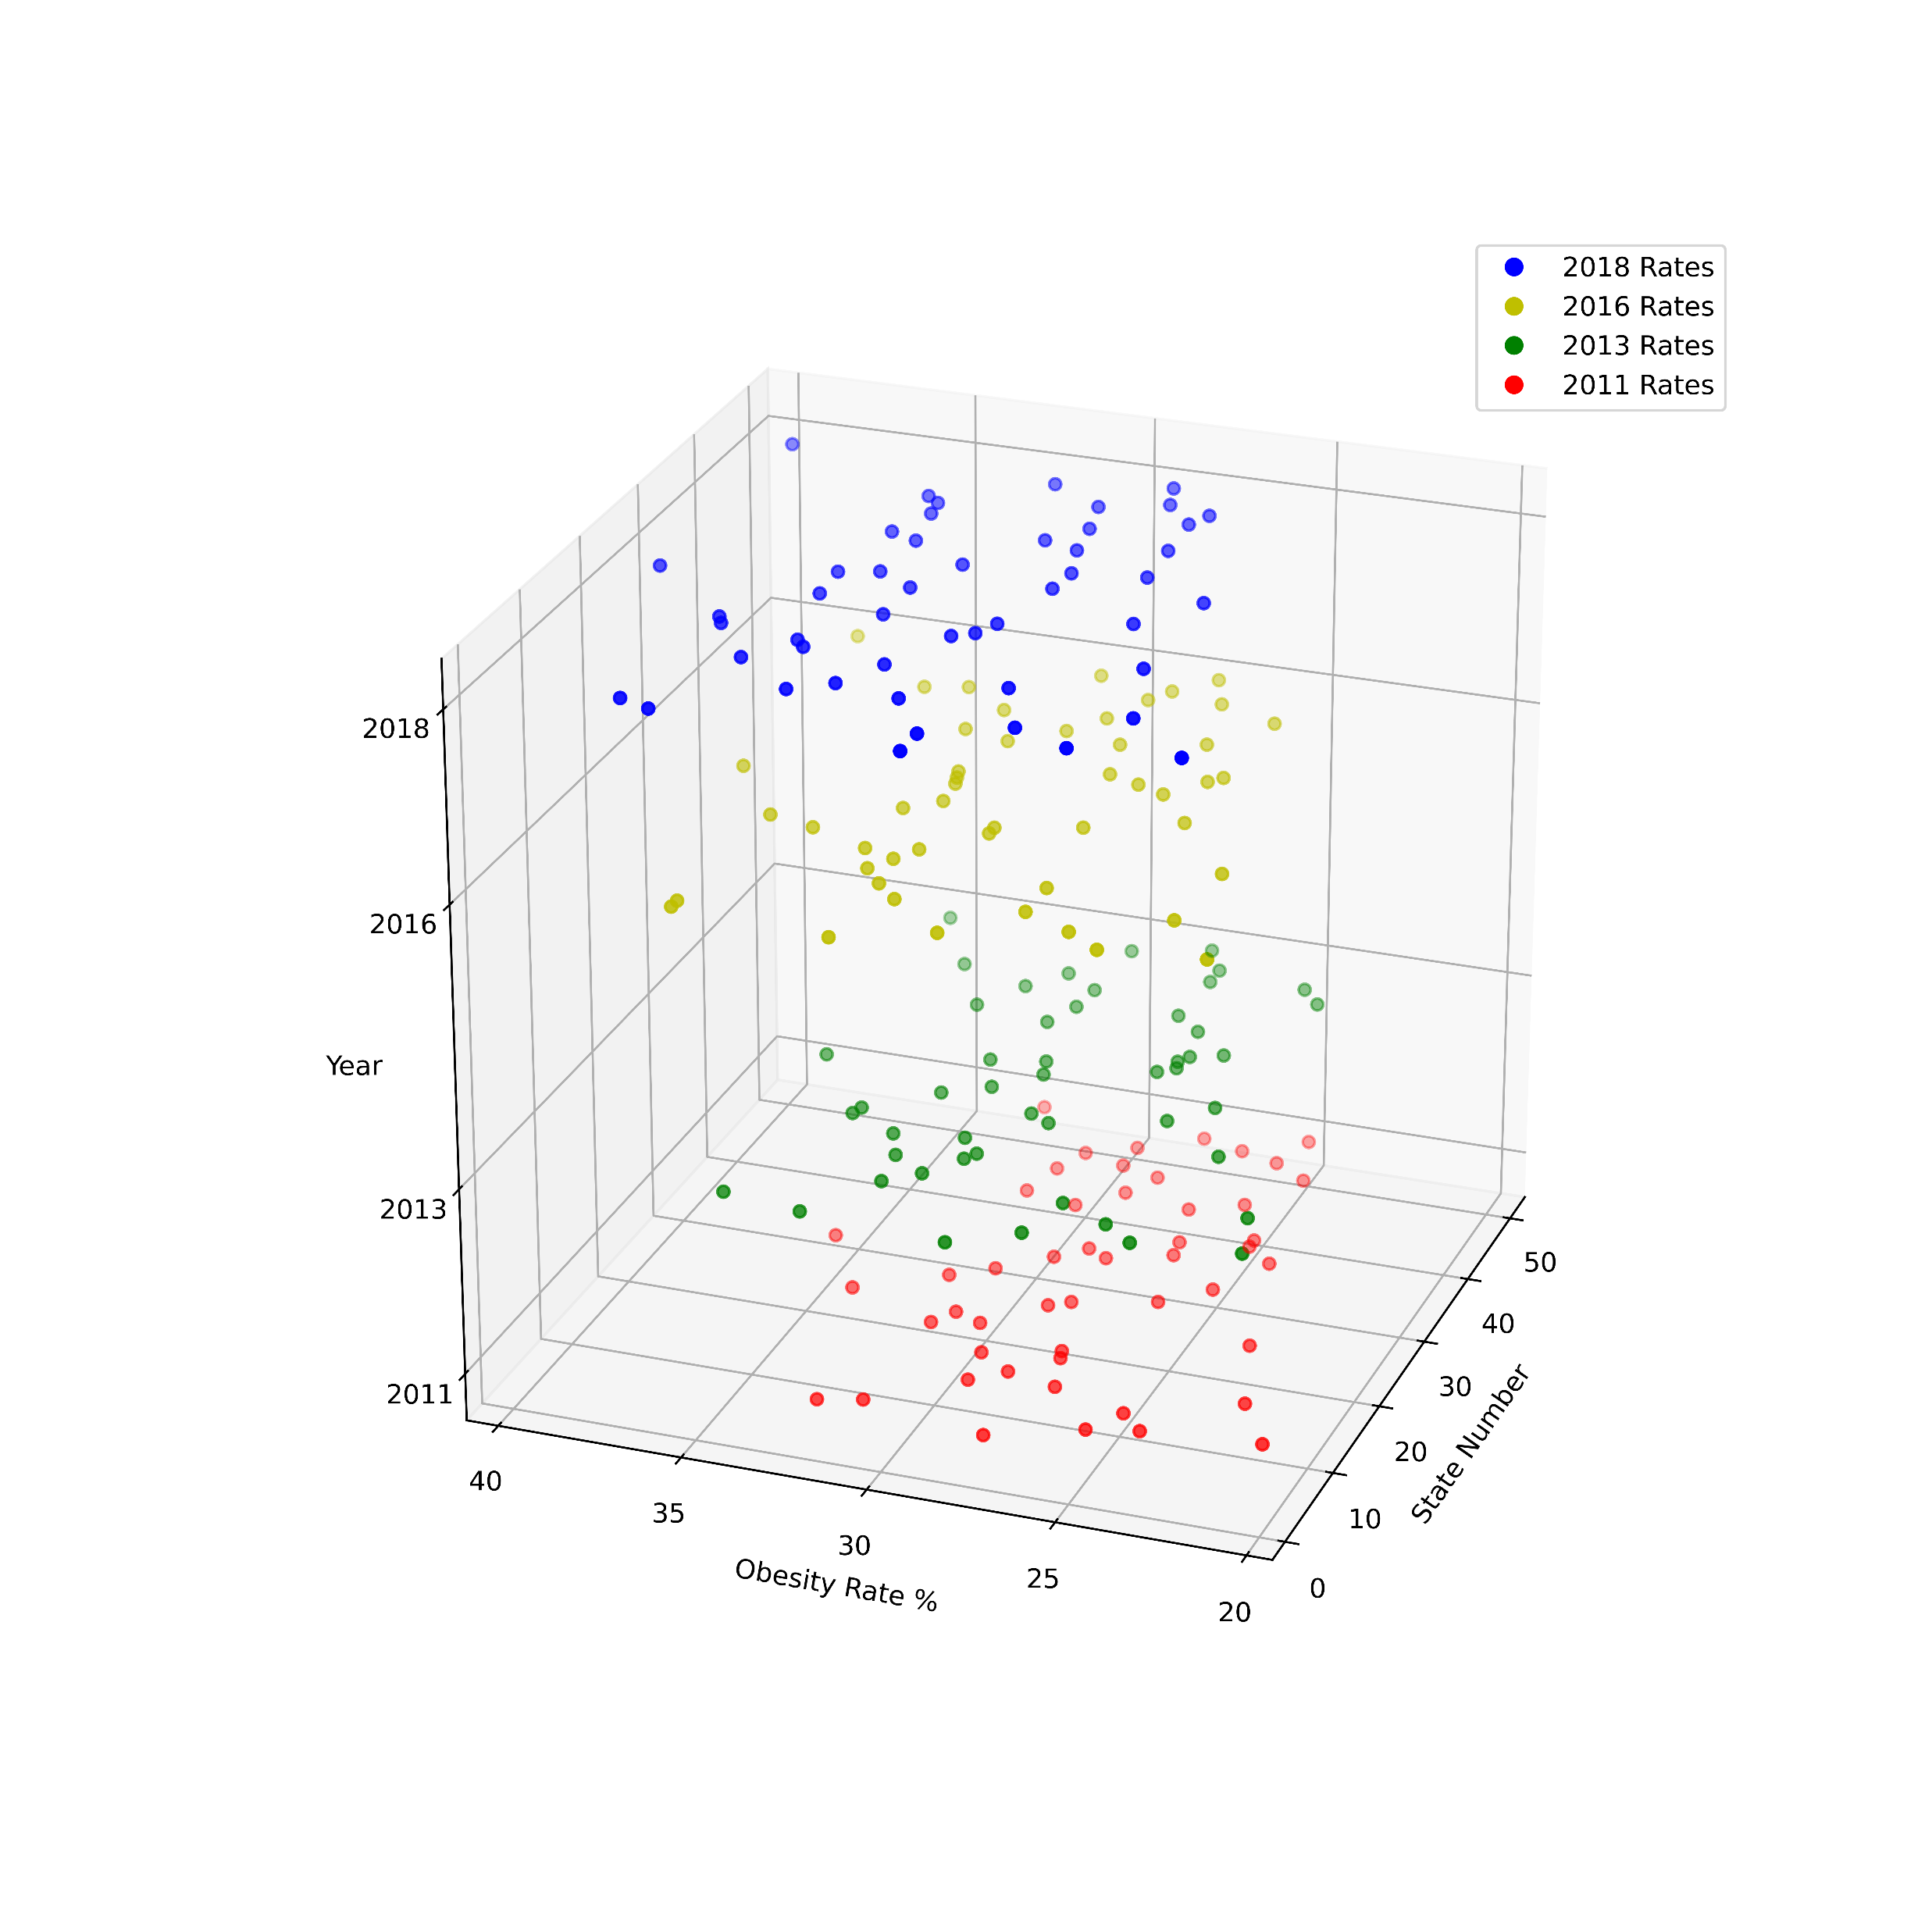
Obesity Rates
2011 - 2018

Slide 4
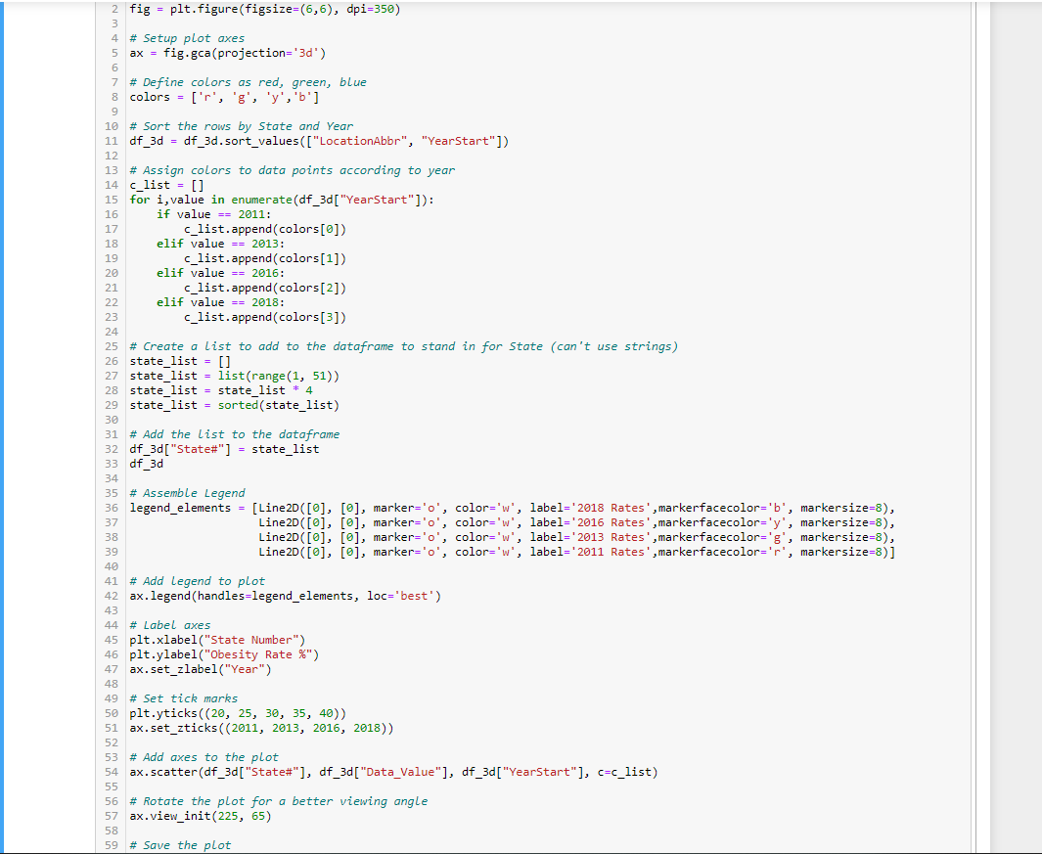
Data Exploration and
Cleanup Process

Slide 5
According to
The Center for Disease Control and Prevention (CDC):
Obesity is weight that is higher than what is considered as a healthy weight for a given height
Obesity is a serious health problem and can increase a person’s risk of other diseases and health problems, such as:
Heart disease
Diabetes
High blood pressure
Certain cancers

Slide 6
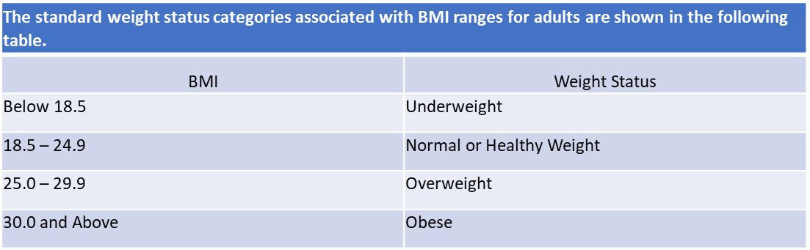
Body Mass Index (BMI)
is used as a screening tool
for determining obesity
BMI is calculated by dividing weight in pounds (lbs) by height in inches (in) squared and multiplying by 703.
Calculation:
[weight (lbs) ÷ (height (in))²] x 703

Slide 7
What is the correlation
of obesity rates to:
Age
1
Gender
2
Education
3
Income
4
Fast Food
5

Slide 8
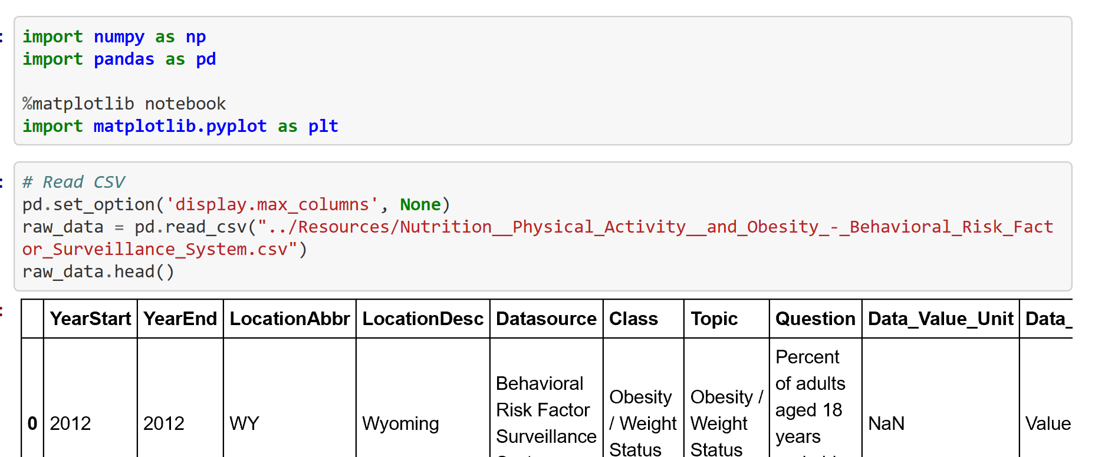
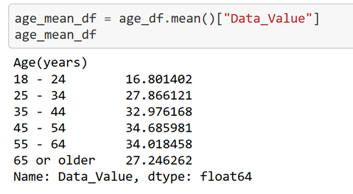
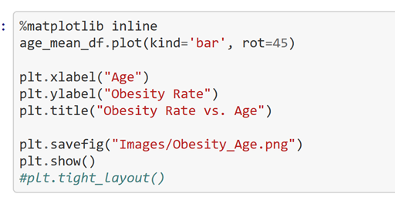
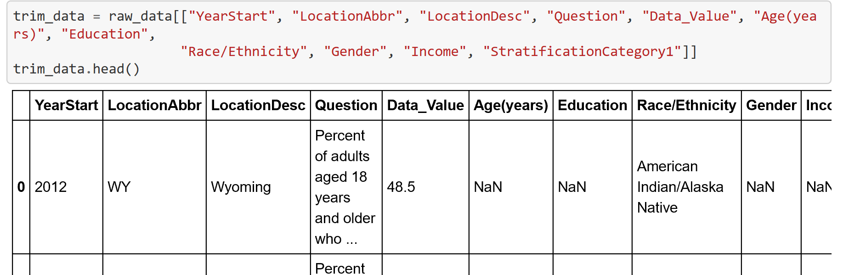
Code
Data Exploration and Cleanup Process

Slide 9
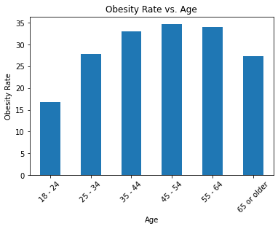
Obesity Rate vs. Age
Is there an age group that has higher/lower obesity rates?
Adults : age 18 – 24 had the lowest obesity rate
Adults: age 45 – 54 had the highest obesity rate

Slide 10
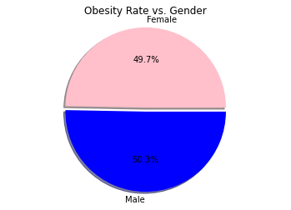
Obesity Rate vs. Gender
Do males or females carry more weight?
There was no significant difference between males and females.

Slide 11
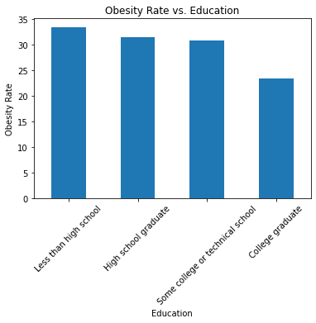
Obesity Rate vs. Education
Is there an education group that has higher/lower obesity rates?
College graduate had the lowest obesity rate

Slide 12
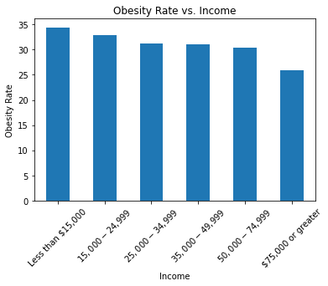
Obesity Rate vs. Income
Is there an income group that has higher/lower obesity rates?
As income increased, obesity rate decreased.

Slide 13
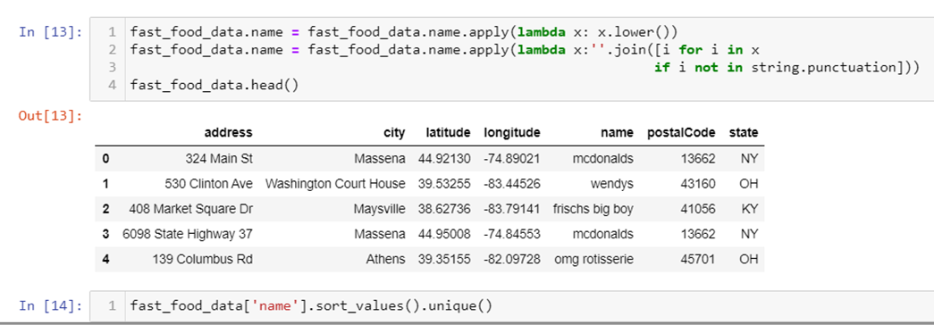
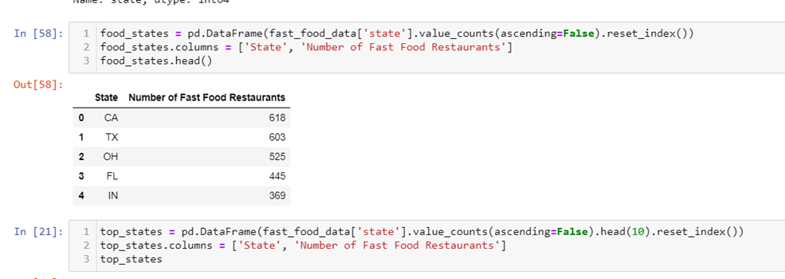
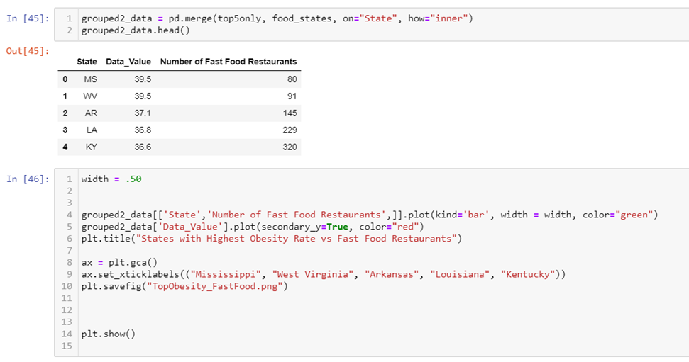
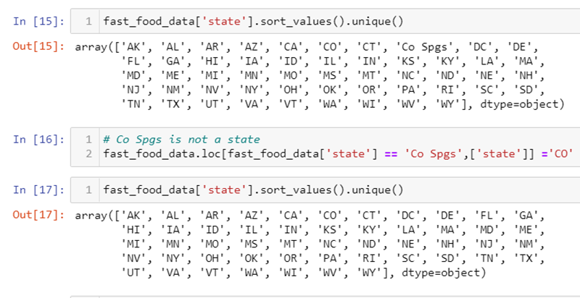
Data Exploration and Cleanup Process

Slide 14
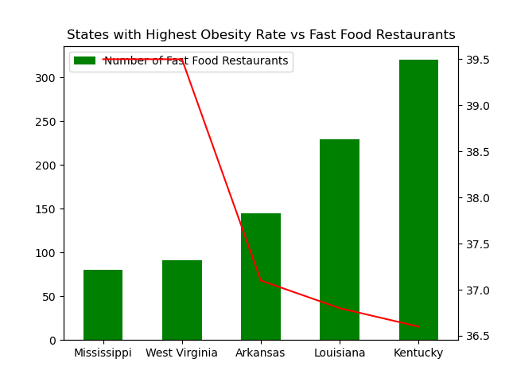
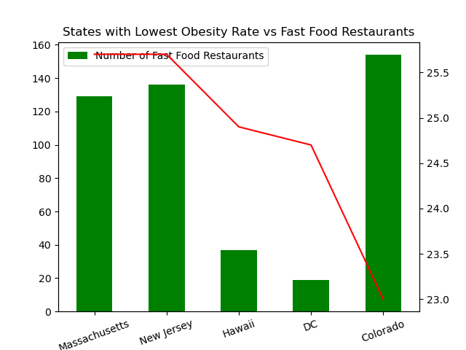
States Obesity Rate
vs
Fast Food Restaurants

Slide 15
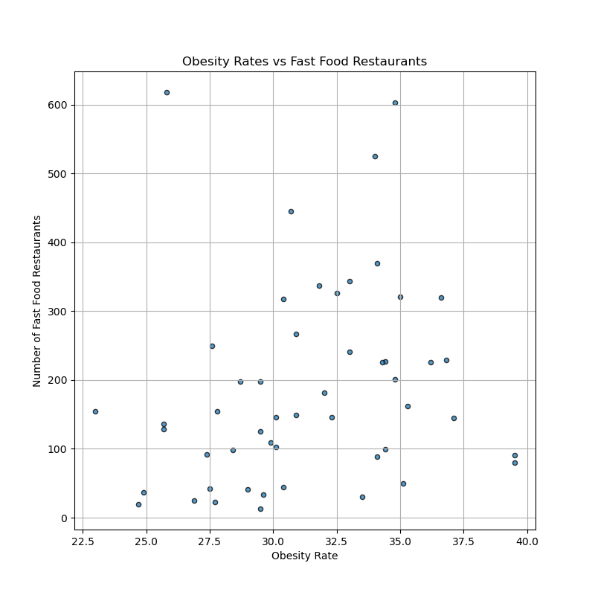
Obesity Rate vs
Fast Food Restaurants
There was no correlation between states with a high number of fast food restaurants and higher obesity rates.

Slide 16
We concluded that states with the highest obesity rates had no correlation whatsoever with the states that had the highest number of fast food locations.
The fast food dataset with a sample size of only 10,000 fast food locations, somewhat limited our results.
Given more time and a budget, we feel we would have had different results.
Conclusion:

Slide 17
References:
Repository: https://github.com/atpappa/Project1
https://chronicdata.cdc.gov/Nutrition-Physical-Activity-and-Obesity/Percent-of-adults-aged-18-and-older-who-have-obesi/tv7q-8s5b
https://www.kaggle.com/datafiniti/fast-food-restaurants?select=Datafiniti_Fast_Food_Restaurants_May19.csv
https://www.cdc.gov
https://www.cdc.gov/obesity/data/prevalence-maps.html
Division of Nutrition, Physical Activity, and Obesity, National Center for Chronic Disease Prevention and Health Promotion

